Slide 1
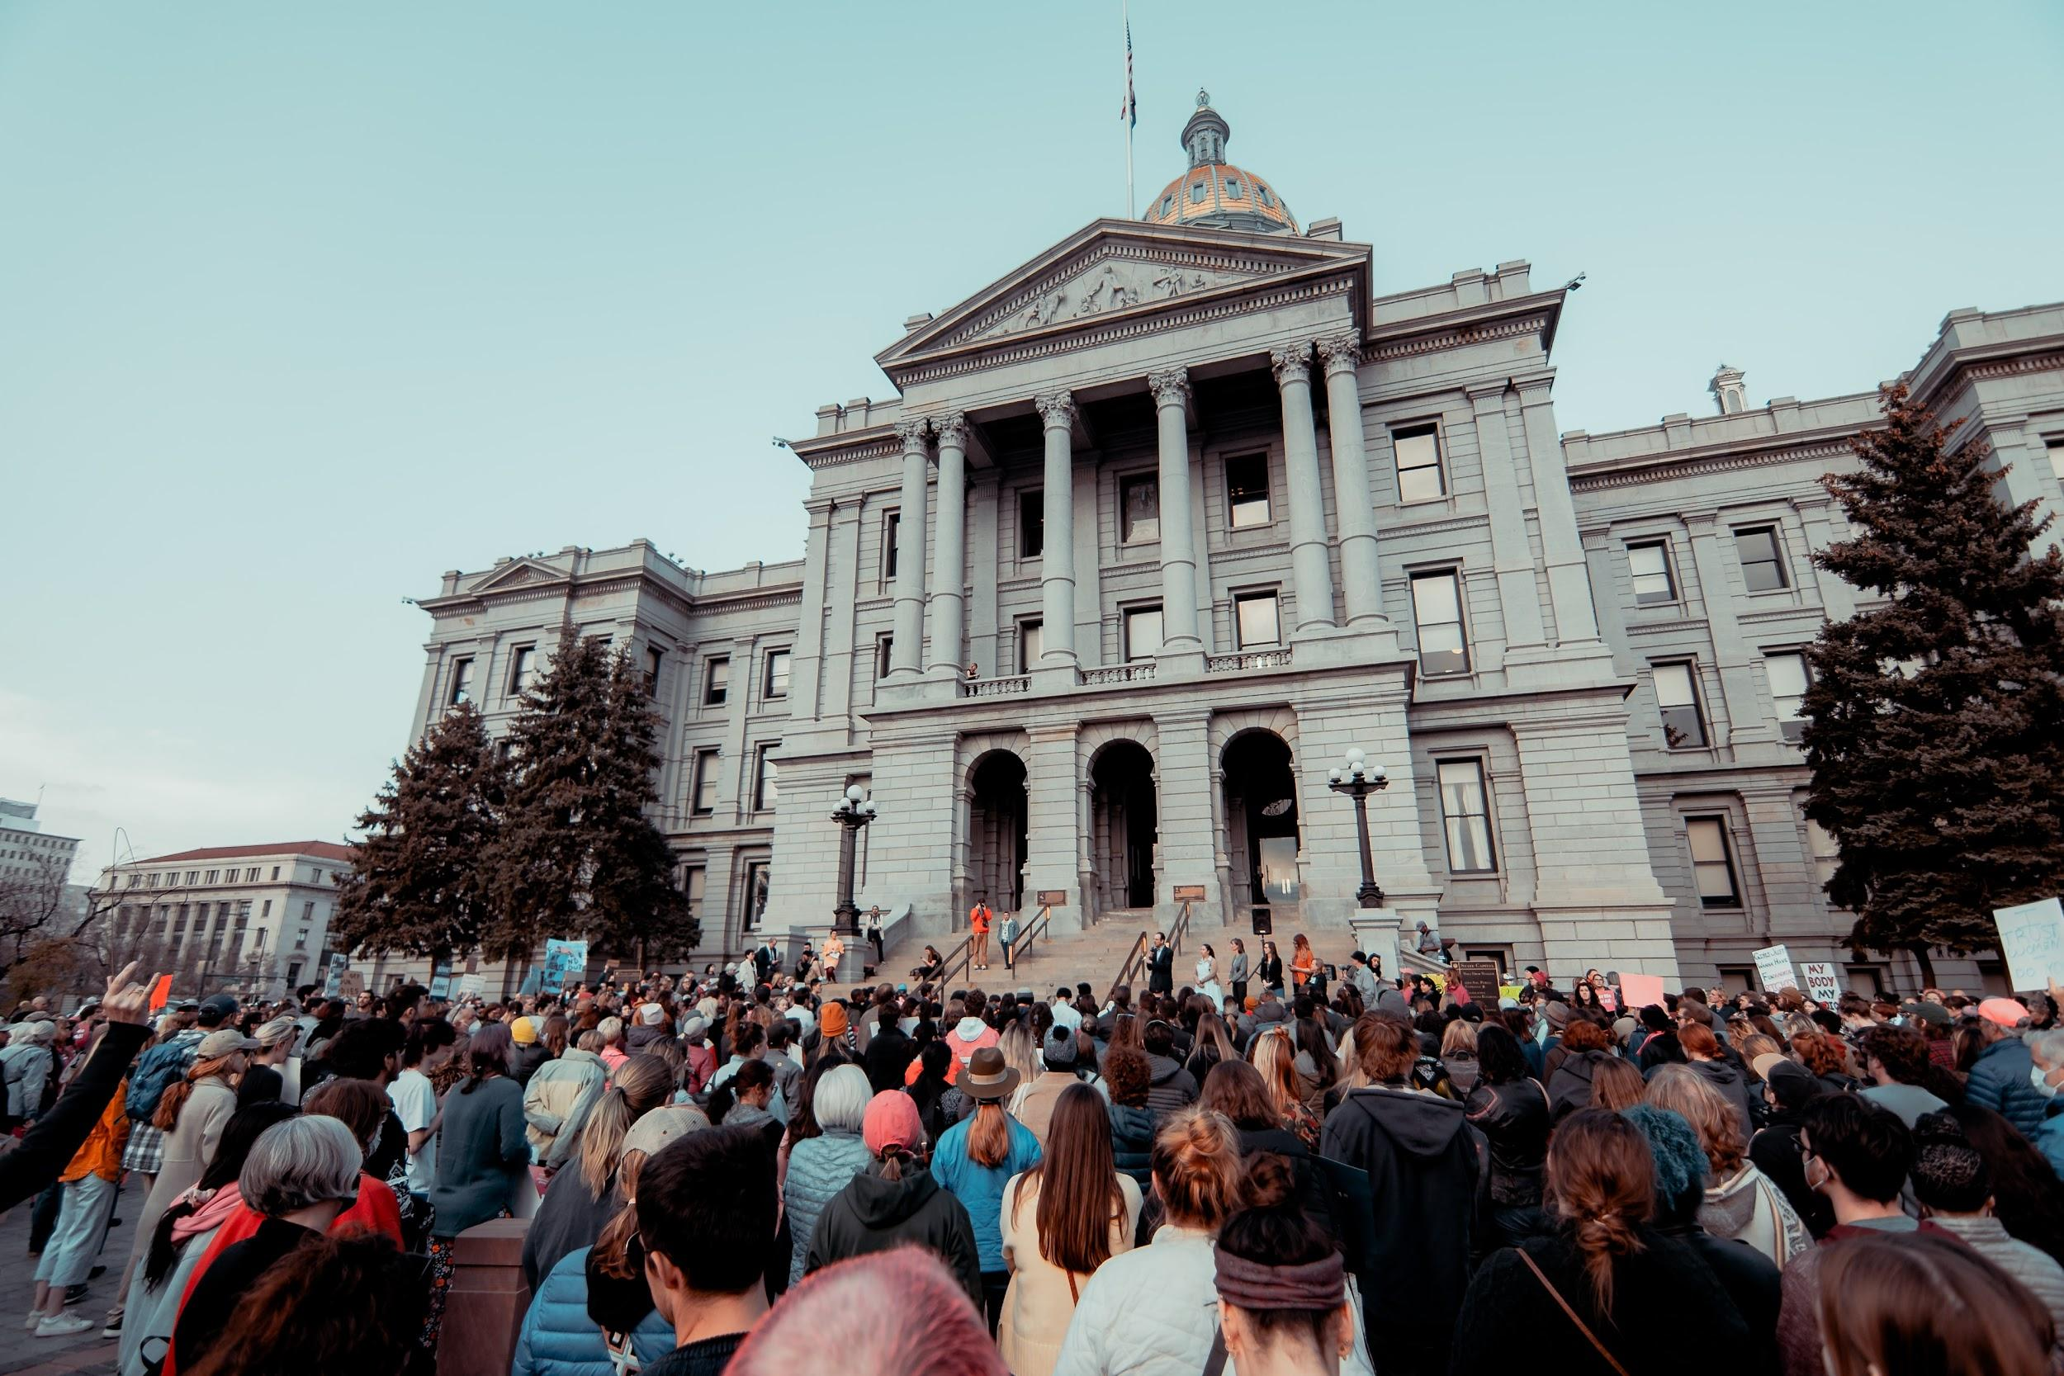
Post Roe v. Wade Privacy & Security
10/16/2022 with Future Ada
Notes:
Welcome to our Post Roe v. Wade Privacy and Security Workshop.
The purpose of this workshop is to help folks who have some concerns about the digital privacy and security concerns that have come up since Roe v. Wade was overturned earlier this summer by the U.S. Supreme Court.
This workshop is being recorded and will be shared along with the slides shortly after we end our session today. Let’s get started.
Photo credit: Colin Lloyd via Unsplash

Slide 2

root@futureada:~$ whoarewe
Spokane, WA 501(c)(3)
Mission: To live in a world where all people feel they not only can belong in STEAM but thrive in it
Offer digital privacy and security assistance, workshops
Notes:
Who is Future Ada?
We are a Spokane, WA-based non-profit and have been operating since 2016.
Our mission is to live in a world where all people feel they not only can belong in STEAM, but thrive in it
As part of that mission, we offer digital privacy and security assistance to individuals or groups. And we also create and offer workshops such as this one. If you enjoy today’s workshop, you will find some materials to some of our previous workshops which cover topics such as privacy and security basics, online harassment, Open Source INTelligence gathering and more.

Slide 3
emilie@futureada:~$ whoami
Future Ada Security Ambassador
Security Researcher/Ethical Hacker
What would you like to see us cover next? emilie@futureada.org
Notes:
As for myself I am Emilie, and am proud to be Future Ada’s Security Ambassador.
My background is in offensive security research, a.k.a ethical hacking
If there is a technology-related topic you would find helpful for us to cover next, please reach out to emilie@futureada.org. We are here to serve the community and would love to hear from you so we can know how to best accommodate your needs.

Slide 4
Notable Events
Notes:
It’s been a busy year when it comes to reproductive rights. Before we get into technical concepts, I’d like to go over a few notable events which happened recently, and have shaped the contents of today’s workshop.

Slide 5
Notable Events
May 2nd: Leaked Roe v. Wade draft
Concerns over reproductive health apps
June 24th: Supreme Court overturns Roe v. Wade
August 8th: News reports on Facebook handing over data used to prosecute abortion in Nebraska
September 28th: CA passes AB-1242 Bauer-Kahan
Notes:
Although the concern over the right to abortion and abortion access across the U.S. has been ongoing for decades, the leaked Roe v. Wade draft on May 2nd really solidified concerns about reproductive rights.
One of these concerns was whether or not reproductive health apps, such as period trackers, may leak or even share data that could later be used to identify folks who are or become pregnant and may later no longer be pregnant. There was a push to delete and stop using such apps after the leak and after June 24th when the Supreme Court dismantled 50 years of legal protections and officially overturned Roe v. Wade.
By then, several states had already been limiting access to abortions via restrictive laws, and nine states further enacted trigger laws which automatically outlawed any abortions. We saw growing media coverage on abortion-related legal matters, including a news report on August 8th about a mother and daughter duo who were being investigated in Nebraska and whose communications were shared by Facebook with law enforcement. Keep in mind that this investigation had started much earlier that year and its timeline wasn’t related to the Supreme Court decision.
However, stories such as this one and concerns that tech companies would be handing over even more data related to abortion investigations compelled California to pass Assembly Bill 1242 Bauer-Kahan. The law prevents CA-based tech companies to comply with out-of-state search warrants related to abortion investigations, among other protections.
I am skipping over a lot of other notable events, but for our purposes today we will be focusing on reproductive health apps and secure communications related to abortion services.
Roe v. Wade draft leak: https://www.politico.com/f/?id=00000180-874f-dd36-a38c-c74f98520000
Concerns over period tracking apps: https://www.theguardian.com/world/2022/jun/28/why-us-woman-are-deleting-their-period-tracking-apps
Roe v. Wade/Dobbs vs. Jackson’s Women Health Org.: https://www.supremecourt.gov/search.aspx?filename=/docket/docketfiles/html/public/19-1392.html
Facbook handed over data for illegal abortion case: https://www.theguardian.com/us-news/2022/aug/10/facebook-user-data-abortion-nebraska-police
AB-1242: https://a16.asmdc.org/press-releases/20220927-governor-newsom-signs-assemblymember-bauer-kahan-and-attorney-general

Slide 6
Operations Security
Notes:
So how do we address digital and security privacy concerns in a Post Roe v. Wade landscape? It starts with Operations Security

Slide 7
Define: Operations Security (OPSEC)
Serves to identify what’s sensitive information, assess risk should it be leaked and protect it
Helps to “put on your evil thinking cap”
Should be applied as consistently as possible
Be wary of how mood, stress, fatigue, habits, medication, etc. can affect OPSEC
Notes:
Operations security (OPSEC) is a term that comes from the military and is often used in information security. It involves identifying sensitive information, assessing the risk this would pose should it be leaked into the wrong hands, and protecting that information.
One way to approach OPSEC is to put on your evil thinking cap. Put yourself into your opponent’s shoes, and visualize how you may attempt to extract sensitive information and exploit it. It also helps to identify who your threat is. Is it a partner, family members, or a law enforcement agency. How would anyone from that group get access to that sensitive information? And most importantly, how would you protect that information?
OPSEC should also be applied consistently. For example, if you choose to enforce strong and unique passwords across for accounts, these should be enforced across platforms and devices.
We’ve all had days where stress, fatigue or life makes it harder to think about data security is simply not a top priority. That’s ok. Perhaps there are some compensating controls you can have in place for these times. For example, if you take nightly medication which makes you drowsy and live in a household with nosy folks, you’ll remove any sensitive data from your phone as part of your bedtime routine. Perhaps on a day where life is overwhelming, or even the opposite, a day where you’re having drinks, you will decide to hold off on sensitive communications until you are back to normal.
https://csrc.nist.gov/glossary/term/operations_security
https://blog.f-secure.com/what-is-opsec/

Slide 8
Applying OPSEC
Don’t reuse passwords to prevent someone from accessing your laptop and accounts
Don’t type your PIN in front of others
Don’t use social media or unencrypted apps for sensitive communications
Don’t input the address of an abortion provider in Google maps from an account that’s tied to you
Notes:
What might applying OPSEC to our digital life look like? A few examples here…

Slide 9
Applying OPSEC
Delete traces of sensitive information when not needed and regularly
Continue to behave/act normally
…
What might applying OPSEC look like for you?
Notes:
We gave a lot of examples on what not to do, but there are also proactive behaviors you can apply, such as …
I invite everyone to take some time to think about what OPSEC might look like for you?

Slide 10
Reproductive Health Apps
Notes:
Now that we’ve gone over operations security concepts, let’s talk about reproductive health apps. The concern with reproductive health apps is that they can share or sell data collected within the apps, such as identifiers (usernames, email addresses, device serial number, etc.) alongside period, pregnancy or sexual health data. That data can then be shared or sold to data brokers, individuals or even law enforcement agencies.
A key point to remember about app data is that if you have consented for it to be shared, sold or collected within the application’s terms and conditions for use, then it might easily be obtained. In fact, many law enforcement agencies can collect personal data, such as location data, by simply purchasing it, vs. requesting it via regulated channels such as search warrants. The Center for Democracy in Technology did a report on this last year which is worth a read:
https://cdt.org/insights/report-legal-loopholes-and-data-for-dollars-how-law-enforcement-and-intelligence-agencies-are-buying-your-data-from-brokers/

Slide 11
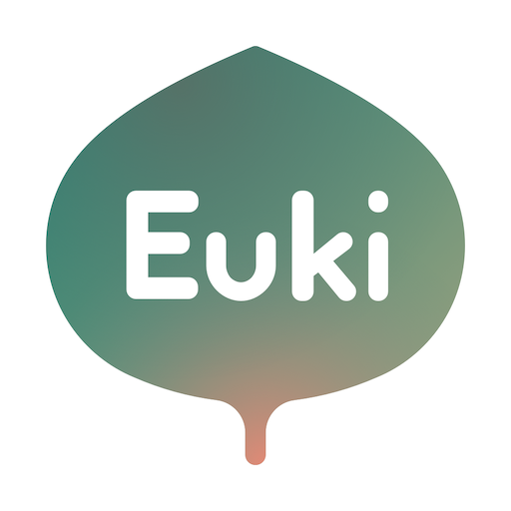
Reproductive Health Apps
Which apps are better at keeping my data private?
Euki (free)
Mozilla Privacy Not Included Project: https://foundation.mozilla.org/en/privacynotincluded/categories/reproductive-health/
Notes:
Rather than throwing in the towel regarding reproductive health apps, are there some which are better than others at keeping data private? Yes! Euki is free and does not collect any data according to the iOS and Play store developer privacy policies. There are others too, Mozilla Privacy Not Included project does a great job of cataloguing these.

Slide 12
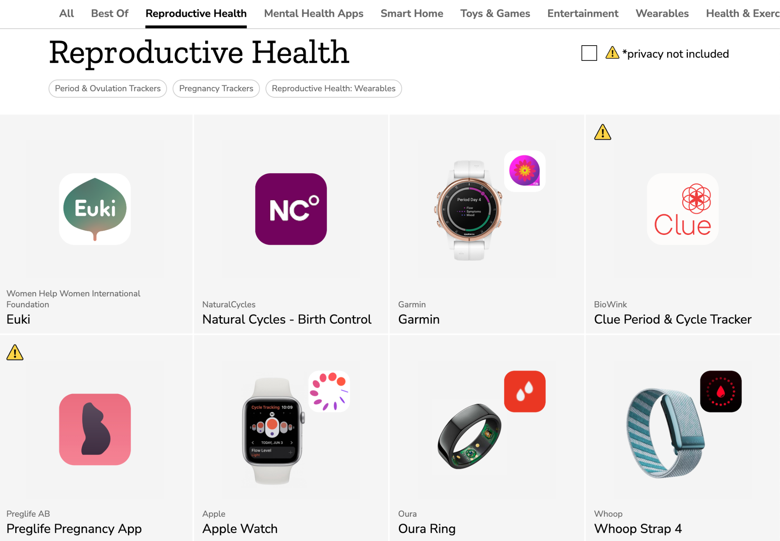

Slide 13
Seeking Help Securely
Notes:
In our Notable Events timeline earlier, I mentioned a story regarding a mother and daughter whose Facebook data, including their communications on how to get abortion pills, had been given to law enforcement in Nebraska. What can we learn from this story to help lower the risk of this happening to other folks who may be seeking help?

Slide 14
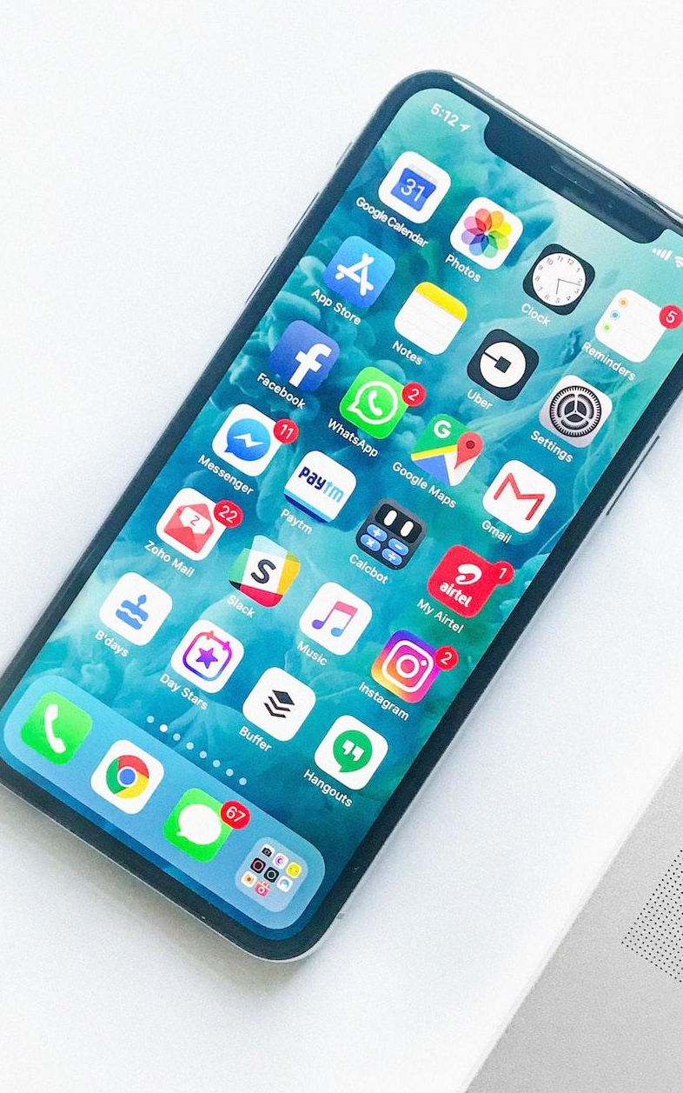
Ensure Your Device is Secure
Keep it up-to-date
Change its password to something unique only you know
Consider removing biometric authentication (Face ID, fingerprint unlock)
Keep apps at a minimum
Notes:
It all starts at the device level, ensuring we implement security from the physical aspects of our device, to our operating system, all the way up to our apps and accounts.
To ensure your device is secure…
Image: Rahul Chakraborty via Unsplash

Slide 15
Ensure Your Device is Secure
Make sure full encryption is configured (follow manufacturer’s guidelines)
If you fear someone may have accessed it, perform a factory reset
Make sure your main account passwords are unique, long and can’t be guessed (Apple ID, Google, Microsoft, etc.)
This can be done with a password manager such as 1Password, LastPass, Bitwarden, etc. ($)

Slide 16

Searching Online
Without a VPN or similar, websites you access can be viewed by school, work, parents, your Internet Service Provider, etc.
Consider using a reputable VPN with a privacy-focused browser or TOR
Notes:
Once your device has been secured following our previous guidelines,
Photo credit Glenn Carstens-Peters via Unsplash

Slide 17
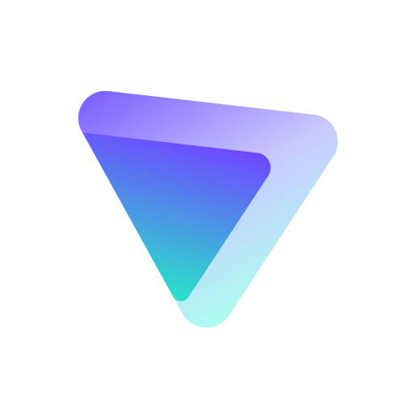
Option 1: VPN and Browser
ProtonVPN has a basic free plan. Available on iOS*, Android and all computer Operating Systems.
Note: Some websites may block traffic coming from free VPN providers
https://protonvpn.com/free-vpn/
Notes:
*Note that some traffic may leak outside of the VPN due to how iOS controls network traffic, not just for ProtonVPN but all VPNs and TOR. See: https://arstechnica.com/information-technology/2022/08/ios-vpns-still-leak-traffic-more-than-2-years-later-researcher-claims/

Slide 18
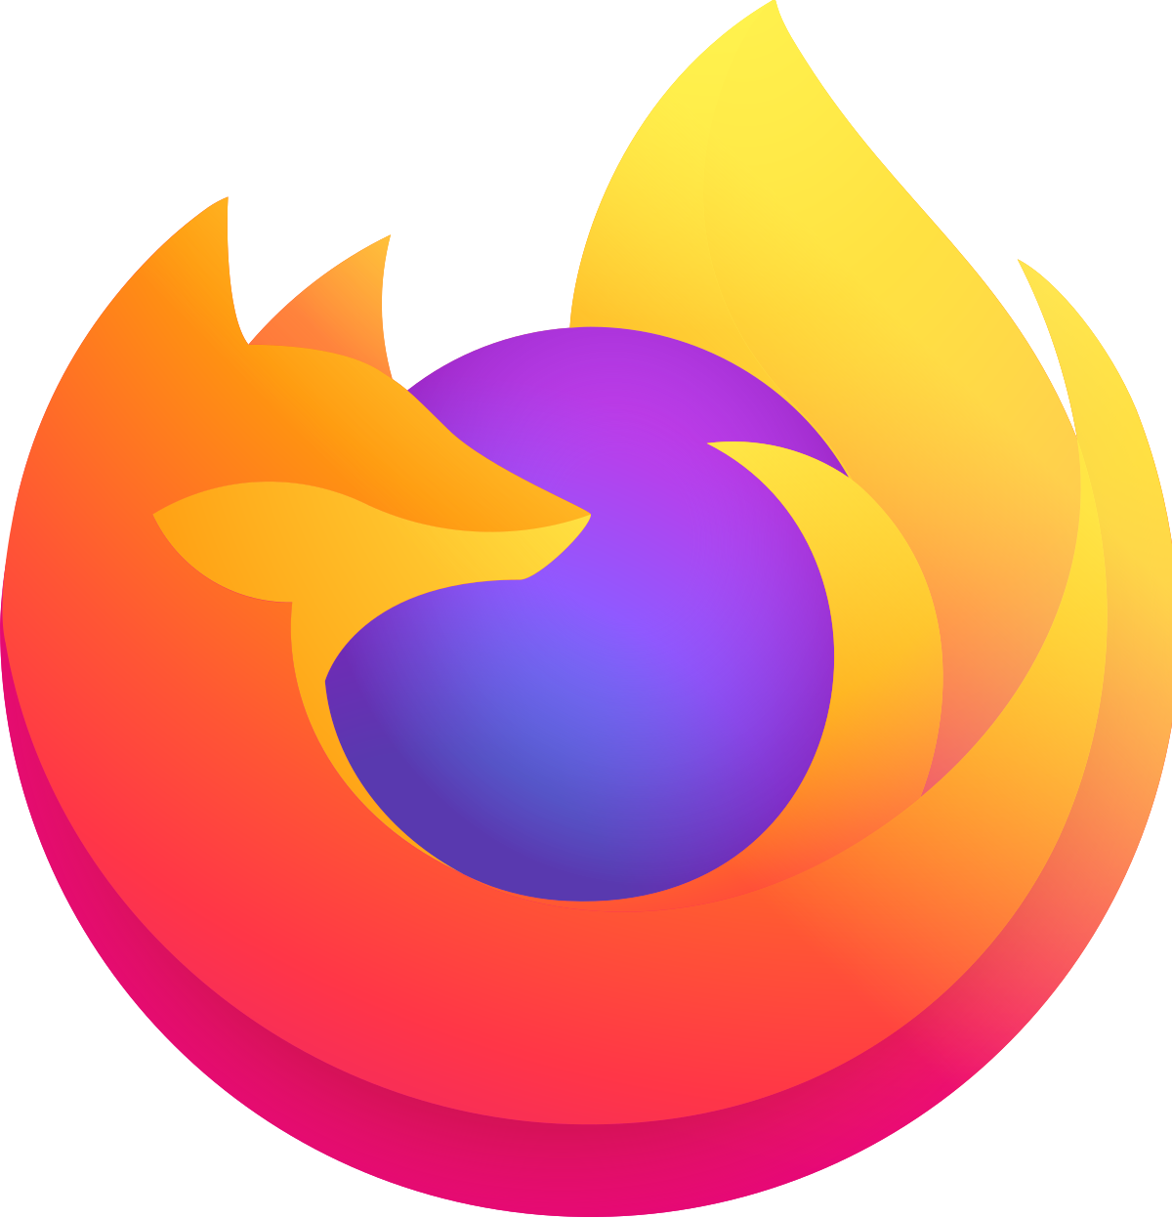
Option 1: VPN and Browser
Firefox Focus app on iOS/Android
Firefox on computers:
Private web browser window
uBlock Origin, Privacy Badger add-ons
Search with DuckDuckGo.com, or browse through our resources (last slides)
Notes:
uBlock origin: https://addons.mozilla.org/en-US/firefox/addon/ublock-origin/
Privacy Badger:
https://addons.mozilla.org/en-US/firefox/addon/privacy-badger17/
DuckDuckGo:
https://duckduckgo.com/

Slide 19
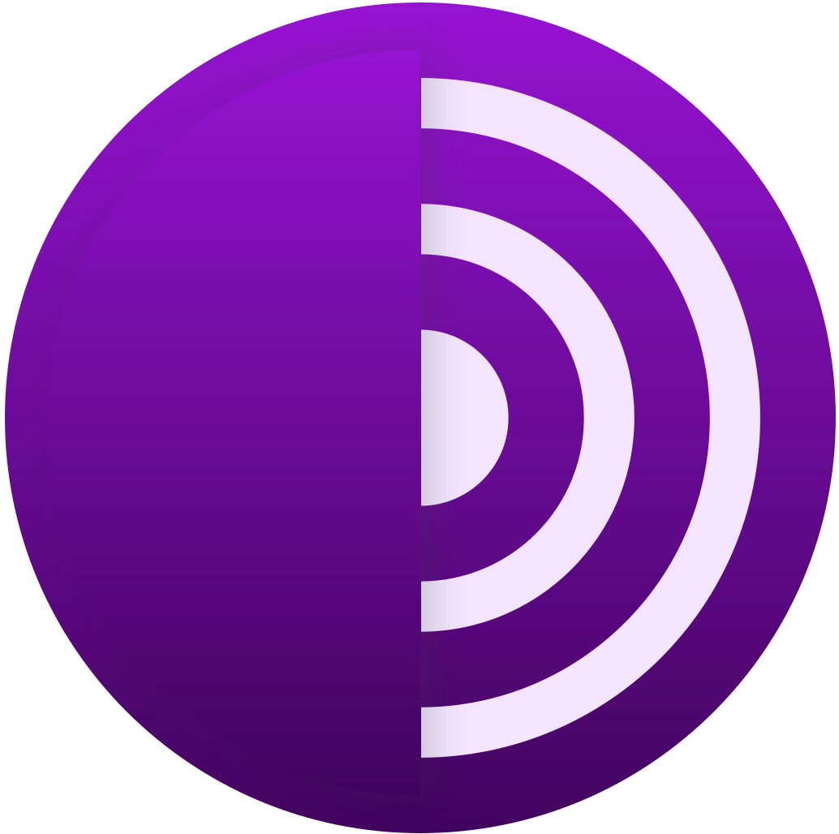
Option 2: TOR Browser
Tor Browser on Android and for all OSs
Onion Browser on iOS*
DuckDuckGo configured as default search engine
Note: Connection (especially initially) can be very slow and requires some patience
Notes:
https://www.torproject.org/download/
*Note that some traffic may leak outside of the VPN due to how iOS controls network traffic, not just for ProtonVPN but all VPNs and TOR. See: https://arstechnica.com/information-technology/2022/08/ios-vpns-still-leak-traffic-more-than-2-years-later-researcher-claims/ and https://github.com/OnionBrowser/OnionBrowser/wiki/Traffic-that-leaks-outside-of-Tor-due-to-iOS-limitations

Slide 20
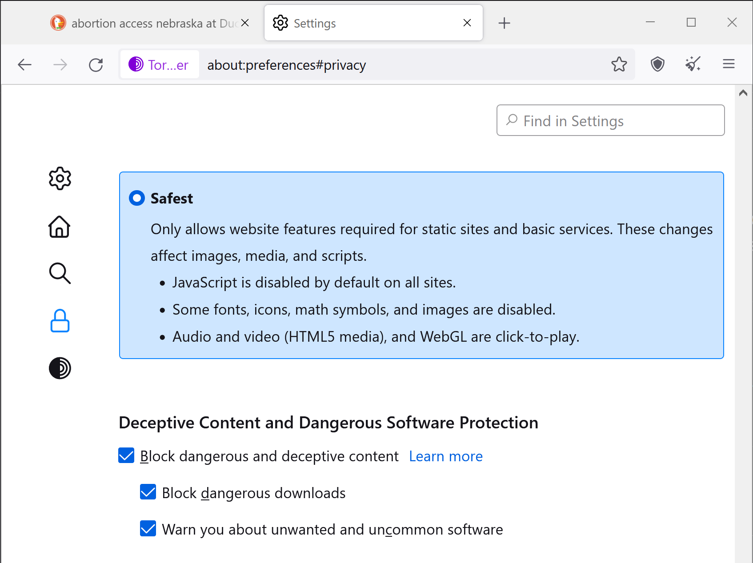

Slide 21

Calling and Texting
Notes:
Photo credit Pradamas Gifarry via Unsplash

Slide 22
Burner Numbers
iOS: MySudo. 1$/month, 10$/year for 1 number. Talk, text, and more.
Android/iOS: Hushed. Starts at 1.99$. 4$/month for unlimited talk and text.
Although free, we do not recommend Google Voice.
Unassign numbers and delete communications and apps when no longer needed.

Slide 23

Signal
For communications with verified and trusted folks
Use a unique PIN that’s hard to guess
Under Privacy > Disappearing Messages. Set messages to automatically disappear. Ex: 30 seconds to 1 hour or customize as needed.
Notes:
https://signal.org/download/

Slide 24
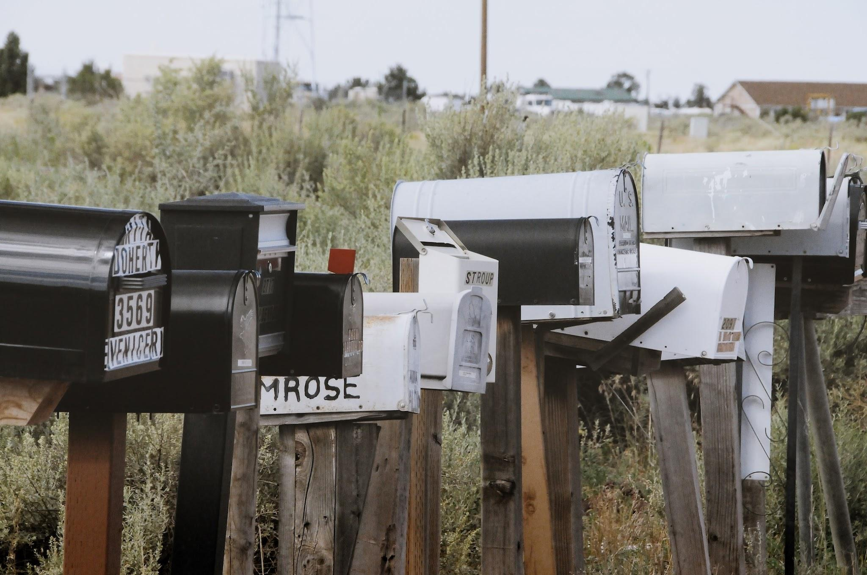
Email
Notes:
Photo credit Yannick Mika via Unsplash

Slide 25
ProtonMail/Proton Ecosystem
From a trusted device and browser, sign-up for a new account.
Also allows access to Proton VPN, calendar and drive
Do not use same Proton account for provider communications and personal use. Create another if needed.

Slide 26
Moving Securely
Notes:
What should you keep in mind if you need to move to a sensitive location?

Slide 27
Moving Securely
Use of a burner phone
Make sure nothing ties it back to your personal digital life (i.e. don’t login to Google, or create a new separate Google services account)
Disabling location services on iOS and Android
Faraday bags
Keep your phone in a Faraday bag or leave it behind before leaving for any health center
Silent Pocket is a reputable choice, but pricey

Slide 28
Closing Notes
Notes:
We can spend an enormous amount of hours locking down our digital life, data and devices. We can spend hours coming up with new ways to defeat surveillance, but in the end, nothing protects us as much as strong, comprehensive legal frameworks for reproductive, privacy and human rights.
I encourage everyone listening to get involved politically and especially to vote for candidates who will help pass and protect such legal frameworks.

Slide 29
Thank You!
FutureAda.org - emilie@futureada.org
Notes:
Thank you for your support and for

Slide 30
Resources
Data Truth. A Post Roe v. Wade World: What Now? Many statistics on reproductive rights and abortion. https://datatruth.medium.com/a-post-roe-v-wade-world-what-now-b760d8fe0a43
Women Help Women. Abortion, contraceptives access and more. https://womenhelp.org/
EFF. Security and Privacy Tips for People Seeking an Abortion. https://www.eff.org/deeplinks/2022/06/security-and-privacy-tips-people-seeking-abortion
Privacy Guides. Forum with updated privacy guides for devices and more. https://www.reddit.com/r/PrivacyGuides/

Slide 31
Resources
Intel Techniques. Data removal, digital security and communications guide. https://inteltechniques.com/links.html

